Slide 1
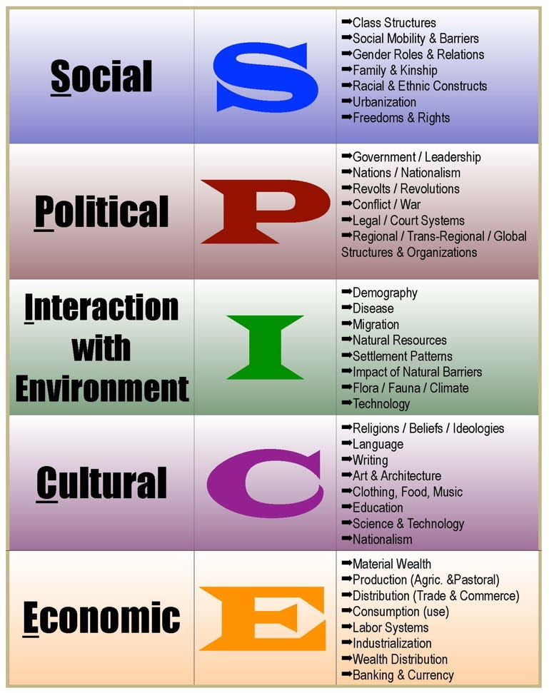

Slide 2
SPICE Warm Up Activity
Reference the chart on the next slide to determine how to categorize each of the following bullet points.
1. Chinese citizens of different provinces can take Civil Service exams to earn a government position. (650 CE)
2. Hunters and gatherers migrate based on the patterns of local animals and seasonal nuts and berries. (9000 BCE)
3. The Persian King Darius declares that he is a demi-god by the authority of the Prophet Zoroaster and thus has true control over the Persian Empire.(6th Cen. BCE
4. Chinese silk merchants become extremely wealthy as their products are desired throughout India and the Middle East. (~300 CE)
5. Early Neolithic settlers build their agricultural settlements near nutrient rich rivers. (3000 BCE)
6. Human domestication of animals and increased urbanization leads to epidemics as diseases mutate from animals to mankind. (~3000 BCE)
7. Women and men share mostly equal status in Paleolithic (Hunter-Gatherer) society, each having a shared set of responsibilities to care for their extended family. (8000 BCE)

Slide 3
Paleolithic vs. Neolithic
Aim: How does the Neolithic Age reflect monumental life change?
Will you survive?

Slide 4
Aim: How does the Neolithic Age reflect monumental life change?
Background: The first major turning point in human history is the Agricultural Revolution (aka Neolithic Revolution). During the Agricultural Revolution, people across the world slowly abandoned hunting and gathering as their means for food and transitioned towards agriculture and more permanent settlements.
In this simulation, you will get a glimpse as to what Paleolithic and Neolithic societies were like and the dangers they faced. The primary motivation for you and your small group is acquiring food (SURVIVAL!). The hunters in your group will be tasked with high risk-high reward, while the gatherers will remain at your encampment and gather food - fruit, vegetables roots, nuts, etc.
You decide whether you want to be a hunter or gatherer.

Slide 5
Aim: How does the Neolithic Age reflect monumental life change?
Paleolithic Survival
Scenario: Each round (3 in total) in Part 1 is the equivalent of a week for a group, as that is the typical length of a hunting trip. Each member of the group will roll a single 6-sided die. The die roll indicates your success at bringing home some food. At the end of the week, all members of the group will pool their food and, if there is enough food, the group will live on another week. If not, someone might starve - which makes it harder for the rest of the group to survive. The group starts with a surplus of 50 food units.
Hunters need to roll a 5 or 6 in order to bring home food. As they work together to hunt an animal, the number of successes they roll as a group increases the amount of meat they bring home. Gatherers need to roll anything but a 1. Each gatherer’s success or failure is individual and the rolls do not compound.

Slide 6

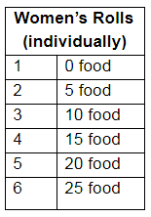

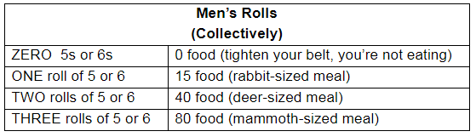
After each person rolls the die, add up the amount of food the group managed to collect. Each person needs 10 food to survive the week. Whatever is leftover is applied to the tally for the next round.
The final step of the round is to start a fire to both cook the food and prevent scavengers from stealing your food in the night. Three members of the group may attempt to roll a die to start a fire - a 5 or 6 is a success. If one member of the group starts a fire, everyone eats warm food and keeps the wild animals at bay. If no one successfully starts a fire, the group survives, but loses 10 food to spoilage and scavengers.

Slide 7
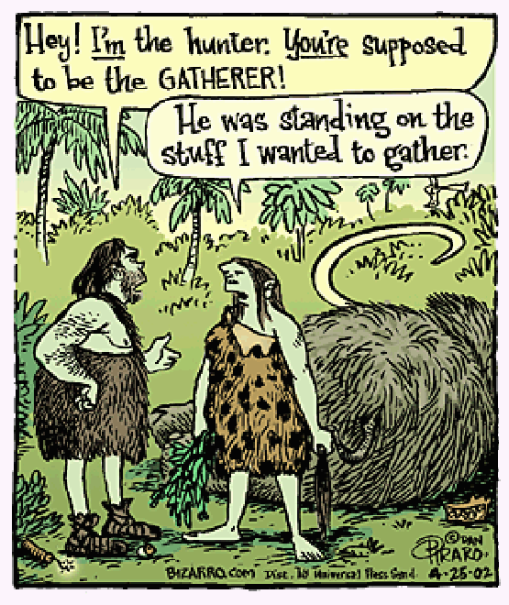
Aim: How does the Neolithic Age reflect monumental life change?
What does the term ‘Revolution’ mean to you?

Slide 8
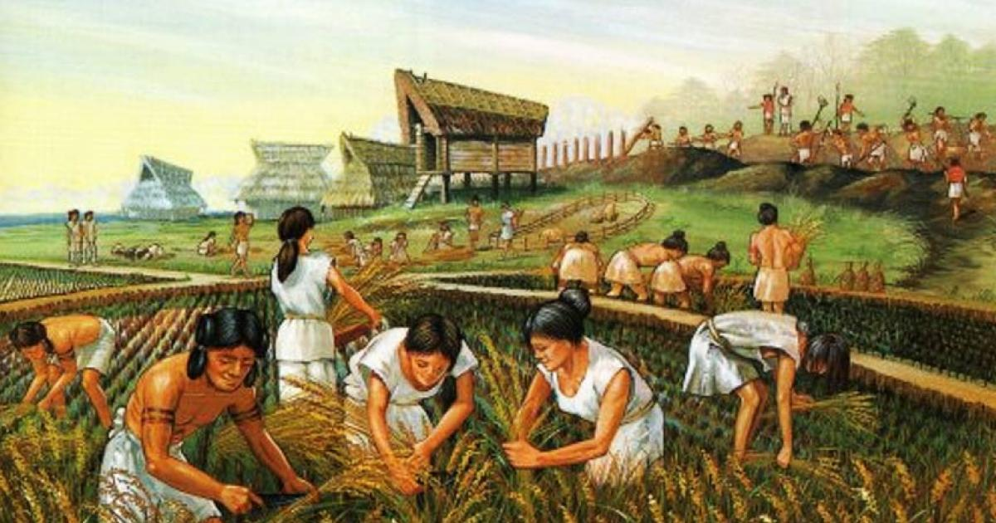
Aim: How does the Neolithic Age reflect monumental life change?
As we participate in the next activity – assess the impact of the agriculture (AKA Agrarian or Neolithic) revolution on the lives of people in the Neolithic Age. Think SPICE ☺
Neolithic Revolution: The New Stone Age between 8000 and 5000 B.C.E; the period of time in which adaptation of sedentary agriculture occurred with the domestication of plants and animals.

Slide 9
Aim: How does the Neolithic Age reflect monumental life change?
Neolithic Survival
Scenario: After many generations, your group gained a tremendous amount of information regarding how plants and animals grow, as well as the natural rhythms and cycles of the planet. Instead of simply hunting animals, men began the process of domestication - taming wild animals. Instead of simply gathering wild edibles, women began harvesting the seeds of the tastiest fruits and vegetables and learning how to control their growth at home.
As the descendants of Paleolithic ancestors (from Part 1), your new group is starting a small agricultural community. You will not move around, looking for food, but stay in one place and grow crops and raise animals. Agriculture is a much different operation than hunting and gathering. While the primary purpose of hunting and gathering was making sure that everyone had enough to eat, agriculture (usually) produces more than enough for everyone to eat. For agricultural communities, the chief concern becomes storing excess food and defending the growing wealth of the community.
In an agricultural community, everyone is engaged in the agricultural process. However, because agriculture is a very labor-intensive enterprise and requires great strength and endurance to produce food, men produce more food than women. Once your group has an excess of 100+ food, select one group member to no longer farm.

Slide 10
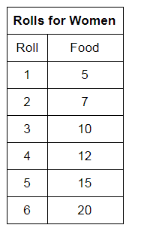
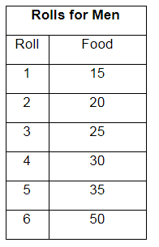
Remember, that the survival of the group is still based on having enough food to eat. Every person needs 10 food units each round to survive. Those not farming need to explain what usefulness they can provide to the town. For the purposes of this simulation, though, they no longer roll. The strength of the community remains with the production of food.
Aim: How does the Neolithic Age reflect monumental life change?

Slide 11
Aim: How does the Neolithic Age reflect monumental life change?
1. As a newly formed agrarian society was gender stratification present?
  -Gender Stratification: refers to the inequalities between women and men regarding wealth, power, and privilege. Gender is a socially structured principle and represents a hierarchical, asymmetrical, and unequal division between men and women
Assess the impact of the agriculture (AKA Agrarian or Neolithic) revolution on the lives of people in the Neolithic Age. Think SPICE ☺

